Slide 1

NAAN MUDHALVAN PROJECT
STUDENT NAME: R.LOHINA THULASI
REGISTER NO AND NMID: 222407895 & autumn1455ds242735
DEPARTMENT: B.SC COMPUTER SCIENCE WITH DATA SCIENCE
COLLEGE: TAGORE COLLEGE OF ARTS AND SCIENCE,CHROMPET
UNIVERSITY:UNIVERSITY OF MADRAS

Slide 2

PROJECT TITLE
DIGITIAL PORTFOLIO
OF
BEAUTY PARLOUR

Slide 3


AGENDA
AGENDA
Problem Statement
Project Overview
End Users
Tools and Technologies
Portfolio design and Layout
Features and Functionality
Results and Screenshots
Conclusion
Github Link
3/21/2024 Annual Review

Slide 4

PROBLEM STATEMENT
"Traditional beauty parlours often struggle with managing appointments, showcasing services, and building lasting client relationships in a digital-first world. Clients face long wait times, lack of transparency in pricing, and limited access to personalized beauty recommendations. There is a need for an intuitive, visually appealing, and mobile-friendly platform that allows beauty parlours to streamline operations, promote their services, and offer a personalized experience to clients—from booking to feedback."

Slide 5

PROJECT OVERVIeW
To design and develop a modern, interactive digital platform for a beauty parlour that enhances client experience, streamlines service management, and showcases the brand’s aesthetic and professionalism. The platform will serve as both a portfolio and a booking system, tailored for beauticians to attract, engage, and retain clients.

Slide 6

WHO ARE THE END USERS?
Freelance beauticians, salon owners, or student entrepreneurs.
Clients / Customers
Women and men of all ages looking for makeup, skincare, hair styling, nail art, etc.
2. Beauticians / Parlour Owners
Freelance beauticians, salon owners, or student entrepreneurs.
3. Collaborators or Partners
Makeup product brands, skincare consultants, or influencers who may co-promote services or collaborate on events.

Slide 7

TOOLS AND TECHNIQUES
HTML→Structure(pages ,sections)
CSS→Styling(colors,layouts,responsiveness)
JAVASCRIPT→Interactivity(navigation menu,animations,form validation)
CODEPEN→CodePen is an online code editor and a social development platform tailored for front-end web developers and designers. It allows users to write, test, and showcase HTML, CSS, and JavaScript code directly in the browser. With its live preview feature, developers can instantly see the results of their code, making it an ideal tool for rapid prototyping, debugging, and learning.

Slide 8
POTFOLIO DESIGN AND LAYOUT
Section | Purpose | Key Elements
Header | Brand identity & navigation | Logo, tagline, theme toggle, nav menu
Hero Section | First impression | Large banner image, welcome message, CTA button
Services | Showcase offerings | Interactive cards with images, descriptions, “Book Now” buttons
Gallery | Visual portfolio | Polaroid-style client photos, hover zoom
Testimonials | Build trust | Carousel of client quotes
About Me | Personal connection | Bio, mission, certifications
Booking Form | Conversion tool | Date picker, service selector, contact info
Footer | Contact & social links | Address, phone, email, Instagram, WhatsApp
8

Slide 9
🧩 Layout Features
🔘 Buttons
Rounded corners, soft shadows
Hover effects: glow or slight bounce
Examples:
Book Now
View Portfolio
Switch Theme (Day/Night)
🧭 Navigation
Sticky top bar with smooth scroll links:
Home | Services | Gallery | Testimonials | Book | Contact
📱 Responsive Design
Mobile-first layout with collapsible menu
Touch-friendly buttons and swipeable testimonial carousel

Slide 10
FEATURES AND FUNCTIONALITY
Homepage with brand identity: Logo, tagline, hero image, and call-to-action.
Service menu: Interactive cards for makeup, skincare, nail art, etc.
Photo gallery: Polaroid-style layout featuring client work and studio shots.
Booking system: Simple form or calendar-based appointment scheduler.
Theme toggle: “Day Glow” and “Night Glam” modes for aesthetic variety.
Testimonial carousel: Auto-rotating client feedback quotes.
Contact section: Location, phone, email, and social media links.

Slide 11
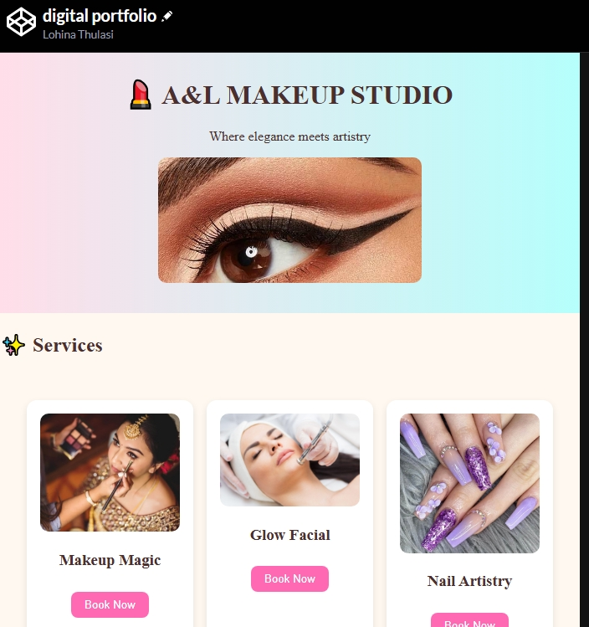
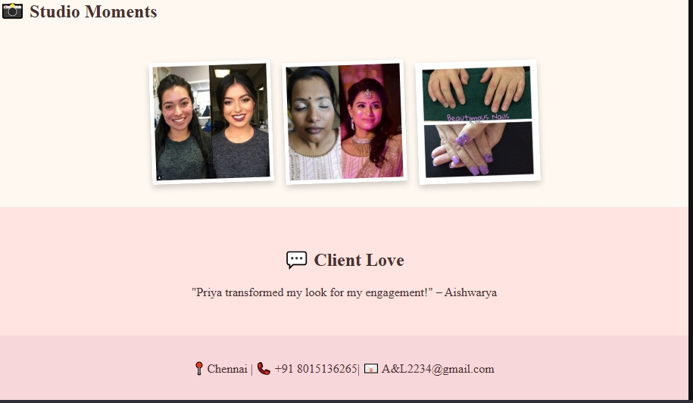

RESULTS AND SCREENSHOTS
3/21/2024 Annual Review
11

Slide 12
CONCLUSION
A fully functional and stylish website that reflects the beautician’s brand.
Improved client engagement through online booking and visual storytelling.
A scalable foundation for future features like loyalty programs or e-commerce.
12

